Slide 1


Slide 2
What is Research?
Research is the activity of getting information about a subject.
You can use these sources for research:
Books
Periodicals
The Internet
Online databases
& more!

Slide 3
What is Research Writing?
Research writing is writing that is based on evidence (these are your sources).
The purpose of research writing is to either inform or persuade your audience.

Slide 4


Slide 5
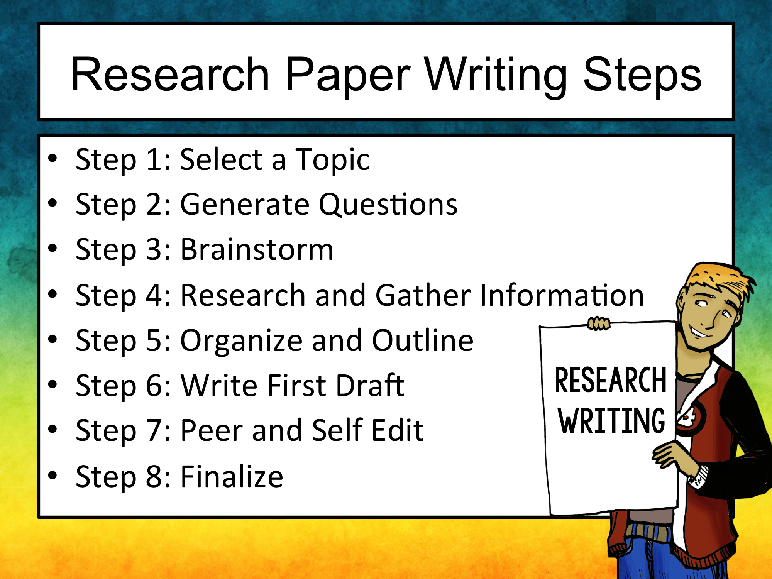

Slide 6
Step 1
Select your topic
You will want to narrow your topic down to a specific topic without being too specific.
If your topic is too specific, you might have a difficult time finding enough information about it.
If your topic is too broad, you will find too much information.

Slide 7

Step 2
Generate Questions
Once you have a topic, generate some questions about the topic.
Try to think about things you would like to know about your topic?
Anticipate questions your audience might like answered.

Slide 8
Step 3
Brainstorm!
Begin thinking about everything you already know about your topic and everything you would like to know about your topic.
Think about what your topic is related to.
Begin thinking about key words and phrases to use in your search.

Slide 9


Slide 10
Step 4
Research and Gather Info
Conduct your research
Use keywords and phrases to locate information
Place “quotation marks” around specific info
Use online databases
Remember to take notes and document your sources as you research.

Slide 11
Step 4
Research and Gather Info
Complete source cards and research notes for each source, or create an annotated bibliography for your sources.

Slide 12


Slide 13
Creating Source Cards
Creating source cards as you conduct your research is an excellent way to keep track of your sources.
A source card is a 3x5 index card that contains a brief summary of your research and all of the information you need to cite that source in your Works Cited Page.

Slide 14
Creating Source Cards
You will have a separate source card for every single source you use. It is important to number each source card to help you keep track of your sources.
front
On the front, write a brief summary in your own words to avoid plagiarism.
back
#
If you write anything word for word, be sure to place quotation marks “ ” around the text.
Write out the citation in MLA format exactly as it is needed for your Works Cited Page

Slide 15
Look for this information
When searching your source, record this information to help make citing sources easier!
Author(s) and/or editor(s) names
Article name in quotation marks
Title of the website, project, or book
Version numbers or posting dates
Publisher information (publisher name and publishing date)
Date you accessed the material

Slide 16


Slide 17
Reliable Sources
Gather information from reliable sources.
For online research, these domains are best:
.org
.gov
.edu
Stay away from:
.net
.com (teacher must approve .com sites)
Personal blogs, message boards, Wikipedia, Ask.com

Slide 18


Reliable Sources
Online databases, such as EBSCOhost, are ideal for conducting research.
Free, alternate databases include:
ERIC (Educational Resources Information Center)
http://eric.ed.gov/
Google Scholar
http://scholar.google.com/

Slide 19


Slide 20
Step 5
Organize and Outline
Create an outline with all of the information you researched
Use your source cards to determine what information should go where
You should create an outline with an introduction, body, and conclusion

Slide 21
Step 5
Organize and Outline
Place like information together in the same body paragraphs.
Find quotes that best support your topic sentences.
Place the most important information toward the beginning of body paragraphs.

Slide 22
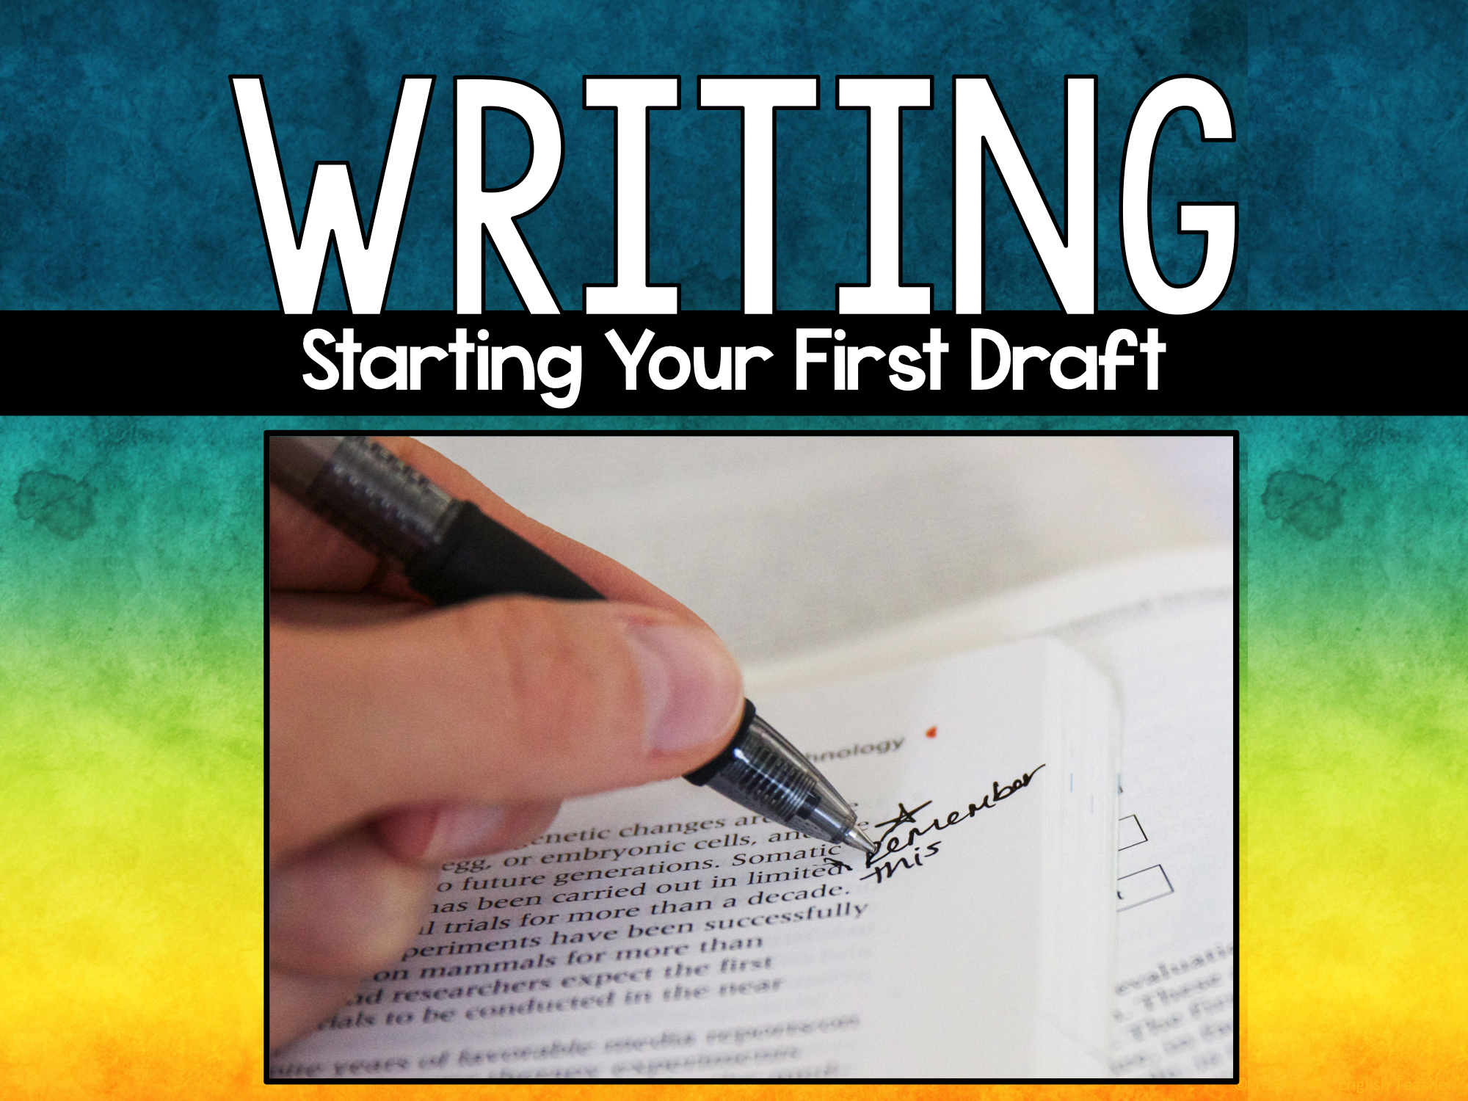

Slide 23
Step 6
Write the First Draft
Using your outline, begin writing your rough draft
Write your draft in third person
Do not use I, me, we, us, you, you’re, and other second and third person personal pronouns
Be objective
Only include researched facts. No Opinion!

Slide 24
Step 6
Write the First Draft
Do not write about your writing.
NO: In this paragraph, I will write about a significant technological development.
YES: The stop light is a significant technological development of the 19th century.

Slide 25
Step 6
Write the First Draft
Do not write about your writing.
NO: For example, as this quote states, “it was not uncommon for…”
YES: Before the traffic light’s invention, “it was not uncommon for...”

Slide 26
Sources
Ideally, no more than 15% of your paper should be direct quotations
Paraphrase as much as you can
Use direct quotations when citing a statistic or information that needs to be captured word-for-word
Use the original author's words if they capture a point exactly

Slide 27
Paraphrasing, Quoting & Summarizing
You still must cite your source if you…
Paraphrase
Put someone else’s words ideas into your own words
Quote
Use the original authors words, word for word, within quotation marks
Summarize
Shorten someone else’s words and ideas

Slide 28
When to Cite
You must provide citations for…
Any research you quote, summarize, or paraphrase
Someone else’s opinion
Concrete facts not considered “common knowledge”

Slide 29
Step 7
Peer and Self Edit
Edit and revise your rough draft
Proofread you own paper
Type your paper into an online translator and have it read back to you
Participate in peer reviews

Slide 30
Step 8
Finalize your First Draft
Type your research essay in MLA format using Google Docs, Microsoft Word, or another word processing application.

Slide 31
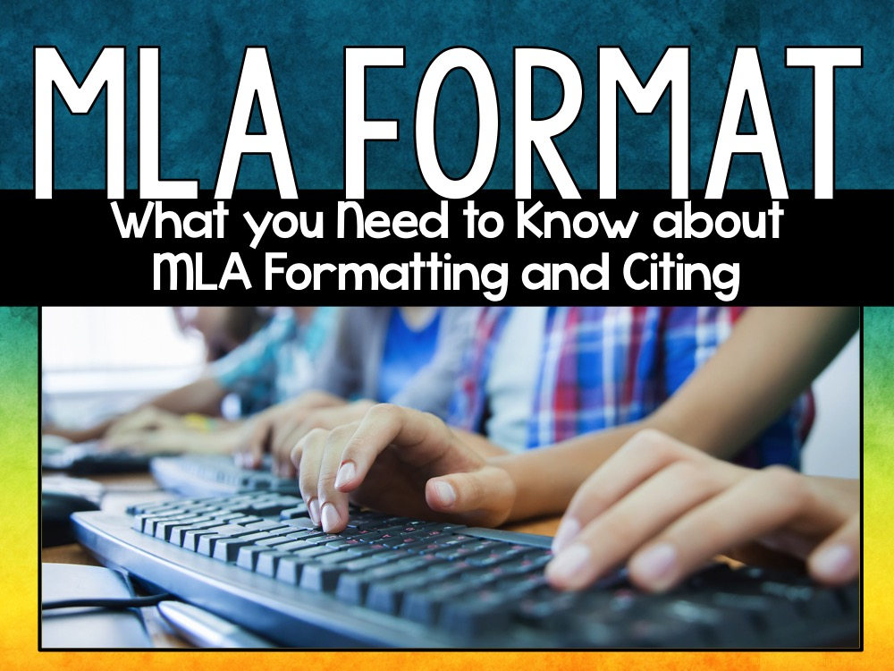

Slide 32

MLA Format
MLA (Modern Language Association)
Most commonly used to write papers and cite sources for liberal arts and humanities

Slide 33
Why Use MLA Format?
MLA style gives writers a system for citing their sources (parenthetical citations and Works Cited pages)
Writers who use MLA style build their credibility

Slide 34
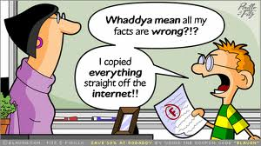
Why Use MLA Format?
It protects you from plagiarism accusations

Slide 35
Paper Guidelines
Use standard, white 8.5 x 11-inch paper
Double-space the text of your paper
Standard font (Times, Calibri, Arial, Cambria, etc.)
12 point font
Leave only one space after periods or other punctuation marks
One inch margins on all sides of your document
Use the tab key to indent each paragraph

Slide 36
The 1st Page of the Paper
No title page
In the upper left-hand corner of the first page, list:
your name
instructor's name
course title
date the assignment is due (day month year)
Add a header in the upper right-hand corner of the document
Last Name page number ex: Smith 1
Center the title and type it in plain text
Use italics when referring to other works in your title

Slide 37
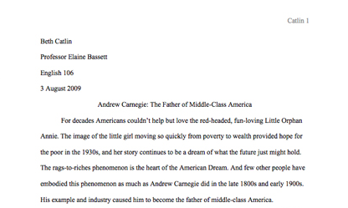
First Page Example
Header
One inch margin
Heading
Paper Title
Indented paragraph
One inch margin
One inch margin

Slide 38

EXAMPLE VIDEO

Slide 39
Works Cited Page
To create a Words Cited page…
Create your Works Cited page on a new page in the same document
Label the page Works Cited in the center
Double space all citations, but do not skip spaces between entries
Create a hanging indent for all listings
List entries in alphabetical order

Slide 40
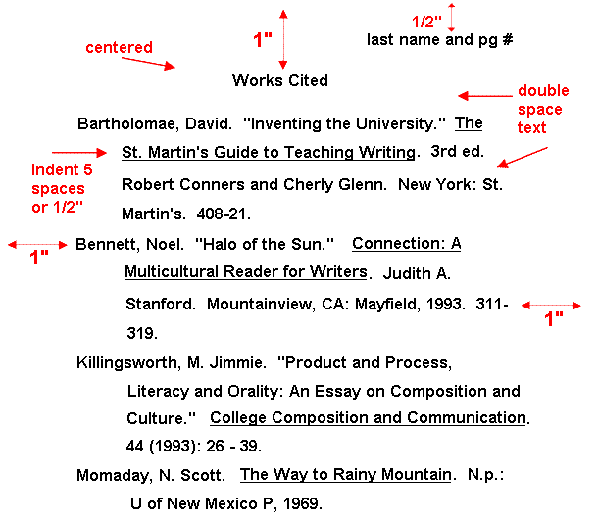

Slide 41
How to Cite Web Sources
Entire Web site
Author’s or Editor’s last name, first name [if given]. Name of Site. Version number, Name of sponsor or publisher. Date resource was created. URL. Date of access.

Slide 42
How to Cite Web Sources
Article from a Web site
Author’s or Editor’s last name, first name [if given]. “Title of Article.” Title of web site. Publisher Name, publication date. URL. Date of access.

Slide 43
How to Cite Web Sources
Article in an Online Database/ Scholarly Journal
Author’s or Editor’s last name, first name [if given]. “Article Title.” Title of Publication, any volume or issue number, year of publication. Electronic Subscription Service, DOI.

Slide 44
How to Cite Print Sources
Encyclopedia
Author’s last name, first name. [if available] “Article Title.” Title of Encyclopedia. Year Published. Print.

Slide 45
How to Cite Print Sources
Book with One Author
Last name, first name. Title of Book. Publisher, Date published.

Slide 46
How to Cite Print Sources
Book with Two Authors
Last name, first name and first name last name. Title of Book. Publisher, Date published.
Book with Three or More Authors
Last name, first name, et al. Title of Book. Publisher, Date published.

Slide 47
How to Cite Print Sources
Book with an Editor
Author’s last name, first name. Title of Book. Edited by editor first name last name Publisher, Date published.

Slide 48
Parenthetical Citation
A parenthetical citation is a citation in the text of your writing to let your readers immediately know where you got your source
*Your parenthetical citation will be the first part of the entry from the Works Cited page
*The period goes outside of the parenthesis.

Slide 49


MLA Citations
Columbia University Professor Jeffrey Johnson spent seventeen years
recording the viewing habits of children in 707 families in Upstate New
York and found that the ones “who watched one to three hours of television
each day . . . were 60% more likely to be involved in assaults and fights as
those who watched less TV” (“Research on the Effects of Media Violence”).
Works Cited
“Research on the Effects of Media Violence.” Media Awareness Network.
2005. www.url.com. 12 Mar. 2005

Slide 50
Works Cited Entry for a Book
The ideal context for identity
formation is “a supportive and
respectful family” (Levine 169).
Works Cited
Levine, Madeleine, Ph.D. See No Evil: A Guide to Protecting Our Children from Media Violence. San Francisco, 1998.

